Slide 1
AIRbnb price predictor
Using Machine Learning

Slide 2

Introduction

Slide 3
What problem I wanted to Solve?
No free and accurate services which help hosts price their properties
No way for travellers to figure out the correct price range based on the features they are looking for
Poorly made paid third party pricing software

Slide 4
Clients / Who will use this model
Airbnb Hosts
Guests looking to book Airbnb Listings

Slide 5
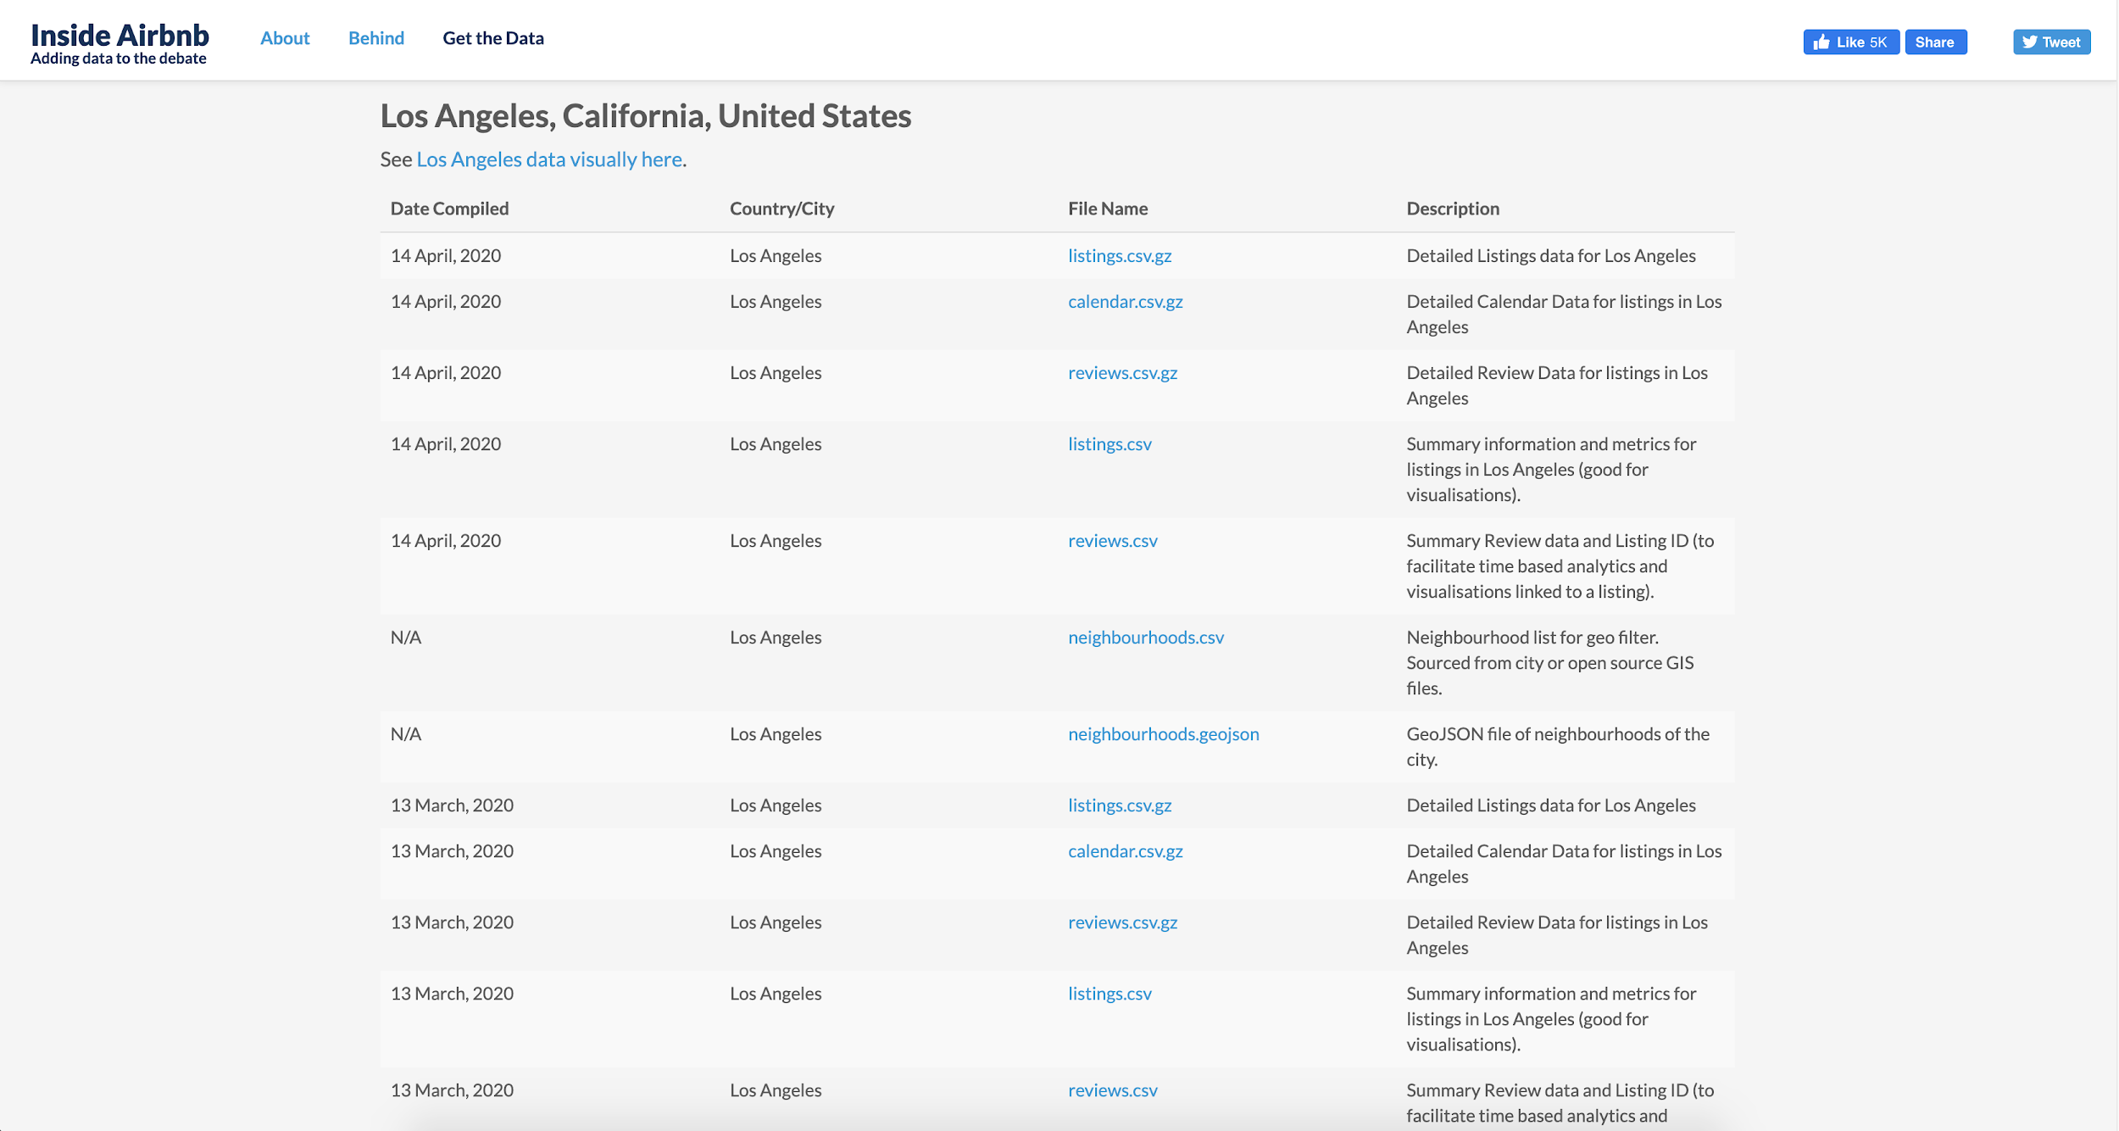
Dataset

Slide 6
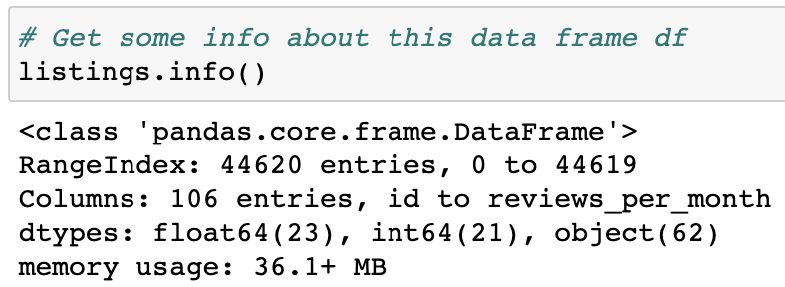
Dataset
http://insideairbnb.com/get-the-data.html
https://www.kaggle.com/gkdoad/airbnb
Rows: 44620
Columns: 106
Data Types
Float64 - 23 columns
Int64 - 21 columns
Object - 62 columns

Slide 7
Data wrangling
Dropped features with free text variables
Dropped duplicate features
Categorical data was converted to numeric type
Biggest challenge was the amenities column

Slide 8
Exploratory data analysis
What are the most important features affecting listing price?
Does location/neighborhood affect listing price?
If location/neighborhood affects listing price, what made these neighborhoods special? and ask follow-up questions if needed.

Slide 9
Exploratory data analysis
Listing price is correlated to accommodates, bedrooms, bathroom, neighborhood, and property type
Property-type-wise, most of the property type of LA listings are house and apartment
About 52% of LA Airbnb listings are 1 bedroom 1 bathroom Airbnbs
Only 2.75% of listings can accommodate more than 10 people

Slide 10
Inferential Statistics
Correlation between an independent and a dependent variable
accommodates, bedrooms, beds, bathrooms do correlate with price.
property_type & neighbourhood_cleansed are also correlated with price.
Correlation between pairs of independent variables
For numerical variables, I checked correlation by pearson correlation coefficient.
For categorical variable vs. numerical data, I used logistic test.

Slide 11
modeling
K-Nearest Neighbors
Linear Regression
Ridge Regression (L2 regularization)
Lasso Regression (L1 regularization)
Random Forest

Slide 12
summary
KNN & Random Forest outperforms Linear Regression models
Random Forest performs better than KNN
Linear Regression models did not perform well because there are less data points with price above 500
Piecewise Linear Regression works better.

Slide 13
Future
While we already tried several models, there are still some interesting future works:
Apply NLP on Airbnb reviews for better listing price prediction.
Apply models on other cities or training models on other cities.
Apply piecewise linear regression.
Apply ensemble models like Gradient Boosting

Slide 14
Notes For professor
Follow the order to run the notebooks
Airbnb_Data_Wrangling.ipynb
Airbnb_EDA.ipynb
Airbnb_Inferential_Statistics.ipynb
Airbnb_Modeling.ipynb
Data is stored in the “Data” folder
Each notebook saves data in .csv format for the next step (notebook)
Labeled data is saved in “Label Encoder” folder
Project won’t run in the absence of these folders.
Project won’t run in the absence of any notebooks mentioned on top.
GPU is required to run “Airbnb_Modeling.ipynb”

Slide 15
THANK YOU

